Slide 1
Chapter 9 OIS Discounting, Credit Issues, and Funding Costs

Slide 2
Treasury Rates
Treasury rates are lower than other very low risk rates because
Treasury instruments must often be held by financial institutions for regulatory purposes
Treasury instruments require no capital
Treasury instruments have favorable tax treatment in the US because they are not taxed at the state level
As a result Treasury rates are not a used by derivatives dealers as a proxy for the risk-free rate

Slide 3
The “Risk-Free” Discount Rate
A risk-free discount rate is in theory necessary to value derivatives
LIBOR and swap rates have traditionally been used as proxies for risk-free rates by derivatives dealers
During the crisis banks were reluctant to lend to each other and LIBOR soared
As a result, practices in the market have changed
For collateralized transactions derivatives dealers now use the OIS rate as the discount rate (It is argued that collateralized transactions are funded by the collateral)
For non-collateralized transactions a rate reflecting the bank’s funding cost is often used

Slide 4
OIS Rates
In an overnight indexed swap a fixed rate for a period is exchanged for the geometric average of the overnight rates
Should OIS rate equal the LIBOR rate? A bank can
Borrow $100 million in the overnight market, rolling forward for 3 months
Enter into an OIS swap to convert this to the 3-month OIS rate
Lend the funds to another bank at LIBOR for 3 months

Slide 5
Overnight Indexed Swaps continued
...but it bears the credit risk of another bank in this arrangement
The OIS rate is therefore less than the corresponding LIBOR rate
The excess of LIBOR over the OIS rate is the LIBOR-OIS spread. It is usually about 10 basis points but spiked at an all time high of 364 basis points in October 2008

Slide 6
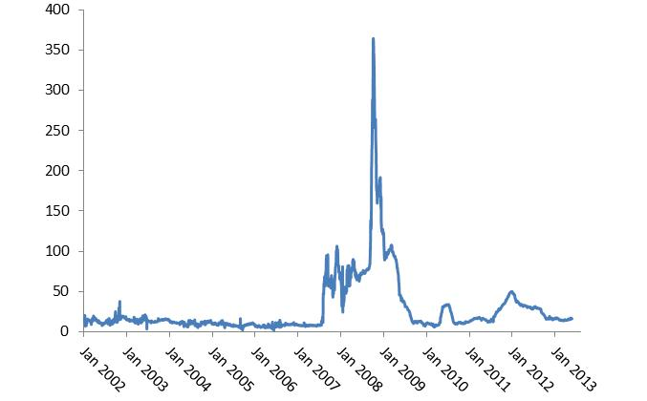
The 3 Month LIBOR-OIS Spread

Slide 7
The OIS Zero Curve
When OIS discounting is used, it is necessary to determine the OIS zero curve
This can be bootstrapped from OIS rates in the same way that the LIBOR/swap zero curve is bootstrapped from quotes for LIBOR-for-fixed swaps
When long maturity OIS swaps do not exist, it is necessary to make an assumption about the spread between OIS swap rates and LIBOR-for-fixed swap rates

Slide 8
Swap Valuation
LIBOR-for-fixed interest rate swaps are always valued on the assumption that forward LIBOR rates are realized
But forward LIBOR rates depend on whether OIS or LIBOR discounting is used

Slide 9
Example
One-year LIBOR rate is 5%
Two year LIBOR-for-fixed swap rate is 6%
Both rates are annually compounded

Slide 10
If LIBOR is used for discounting…
The two year LIBOR/swap zero rate is R where
so that R = 6.030%
The forward LIBOR rate for the second year is

Slide 11
If LIBOR is used for discounting continued
Check:
When the forward rate is 7.0707 and LIBOR discounting is used the two-year swap has a value of

Slide 12
If OIS Discounting Is Used….
Assume that OIS zero rates for one and two years have been bootstrapped as 4.5% and 5.5% with annual compounding
If F is the forward LIBOR rate for the second year then
so that F is 7.0651%

Slide 13
Swap Valuation with OIS Discounting
Forward LIBOR rates are calculated as for this simple example
Typically, 1-month, 3-month, 6-month and 12-month forward rates are calculated separately from the corresponding swap quotes.
Interpolation is used to calculate the forward rates to value a particular existing swap.

Slide 14
Valuing Bilaterally Cleared Derivatives Portfolios
A dealer first calculates the value of a portfolio of derivatives with a counterparty assuming neither side will default
It then reduces the value of the portfolio to reflect possible losses from a counterparty default. This is the credit value adjustment (CVA)
It then increases the value to reflect possible gains from a default by itself. This is the debit value adjustment (DVA)

Slide 15
Valuing Bilaterally Cleared Derivatives Portfolios continued
Value after credit adjustments is:
No-default value − CVA + DVA
CVA and DVA adjustments should reflect collateral arrangements

Slide 16
The CVA Calculation
………………
Time
0
t₁
t₂
t₃
t₄
t_{n}=T
………………
Counterparty default probability
q₁
q₂
q₃
q₄
q_{n}
………………
PV of dealer’s loss given default
v₁
v₂
v₃
v₄
v_{n}

Slide 17
The DVA Calculation
………………
Time
0
t₁
t₂
t₃
t₄
t_{n}=T
………………
Dealer default probability
q₁*
q₂*
q₃*
q₄*
q_{n}*
………………
PV of counterparty’s loss given default
v₁*
v₂*
v₃*
v₄*
v_{n}*

Slide 18
Funding Costs
Many dealers argue that they should take funding costs into account when non-collateralized transactions are valued
This leads to what is known as a funding value adjustment (FVA)
An FVA cannot be justified theoretically…
What discount rate should a company use for an investment in a Treasury bond.
The discount rate for a project undertaken by a company should reflect the project’s risk not the company’s funding cost

